Slide 1


Slide 2

AutoQA.AI
Fluid Code meets Rigid Testing
QA Energetic (Group Number – 6)

Slide 3

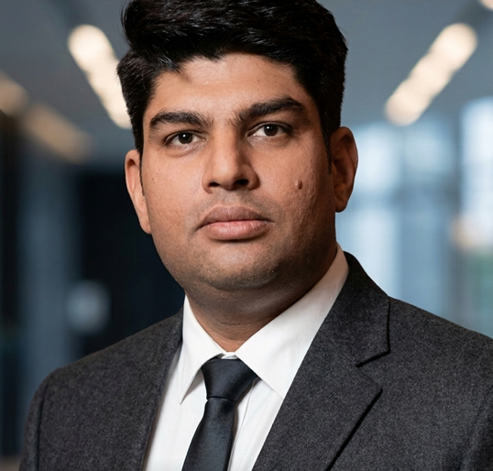
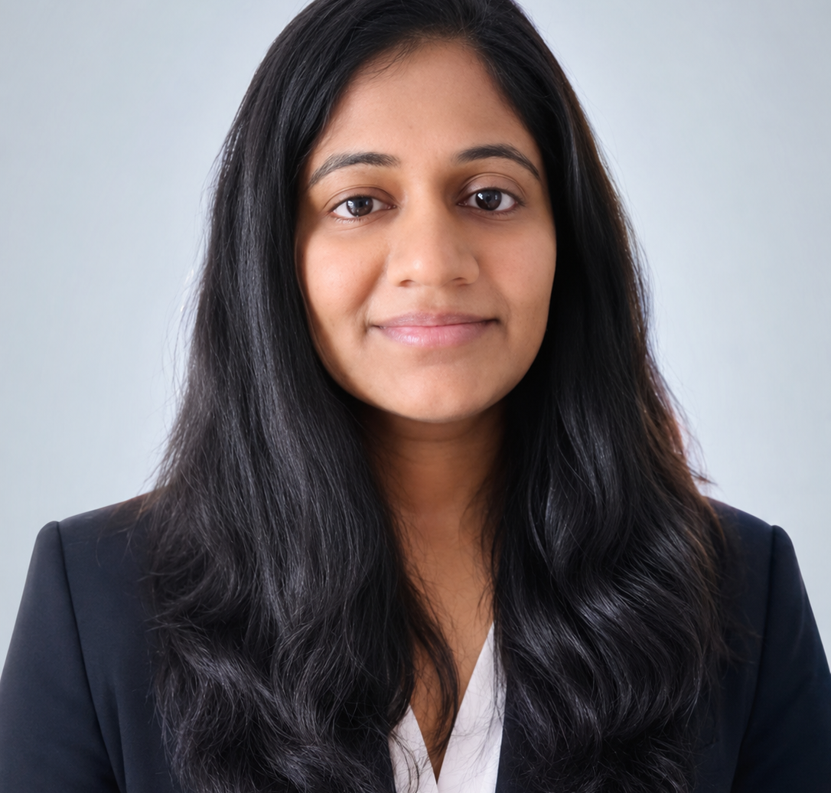


Meet The Team Members OR Your Introduction ✨
Mayank
Deepthi
Varun
Meetu
QA Manager
Director data and analytics
Full Stack AI Product Engineer
Data Engineer- ECM
Building Quality Culture via Engineering Leadership
Transforming business to make data driven decisions
Full Stack Engineer Specializing in AI-Powered Applications
Accelerating Delivery Through Configurable Frameworks

Slide 4

What is the Problem you are solving?
Legacy Web App Testing = Skyrocketing Cost + Broken Production Deployments
Traditional scripting takes lot of time to create and Mantain
Growth
Manual testing is slow and brittle
+
Kills
&
Revenue
+
Innovation

Slide 5

How are you solving the problems?
An autonomous AI enabled solution that explores your web application like a real user, discovering flaws and instantly generating its own durable regression test suites.
AI generated Scripts
Value Add
slashes costs, speeds up releases and ensures flawless software - effortlessly.
Bug Deduction and Reporting
Self Healing Scripts
Expected Output
Solution enables 30-40% of cost savings.

Slide 6

Target Audience
Target Audience (Primary)
Next-Gen AI Builders & Vibe Coders
Enterprise Agile Software Engineering teams
Target Audience (Secondary)

Slide 7
Product Link: Coming Soon

Slide 8
Thank You ✨

